Slide 1

Advanced SQL – Reinforcement Project – IMDB Dataset
BY: THARANI VENKATESH
DA/DS
FEB 2025 BATCH

Slide 2
Introduction to the Dataset
Dataset: Simplified IMDb database.
Contains:
Movie metadata (title, year, duration, etc.)
Genres
Director and role mappings
People info (names, birthdates)
Ratings
Objective:
Use SQL to uncover insights from real-world movie data.

Slide 3
Dataset Structure
Content:
Tables Overview:
movie: Basic movie details
genre: Links movies to genres
director_mapping, role_mapping: Map people to movies
names: Actor/director bios
ratings: Voting and rating data
Relationships:
movie_id links most tables.

Slide 4
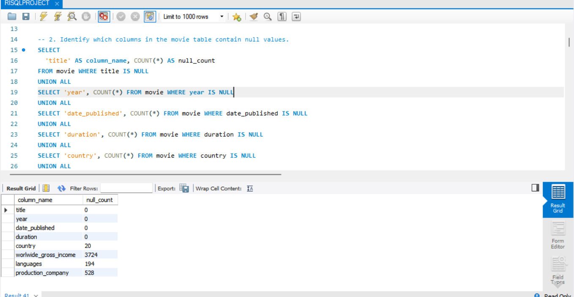
Data Quality & Exploration
Null value check:
Found in movie and names tables.
Table record counts:
All 6 tables reviewed.
Insight:
Null values must be handled in analysis.

Slide 5
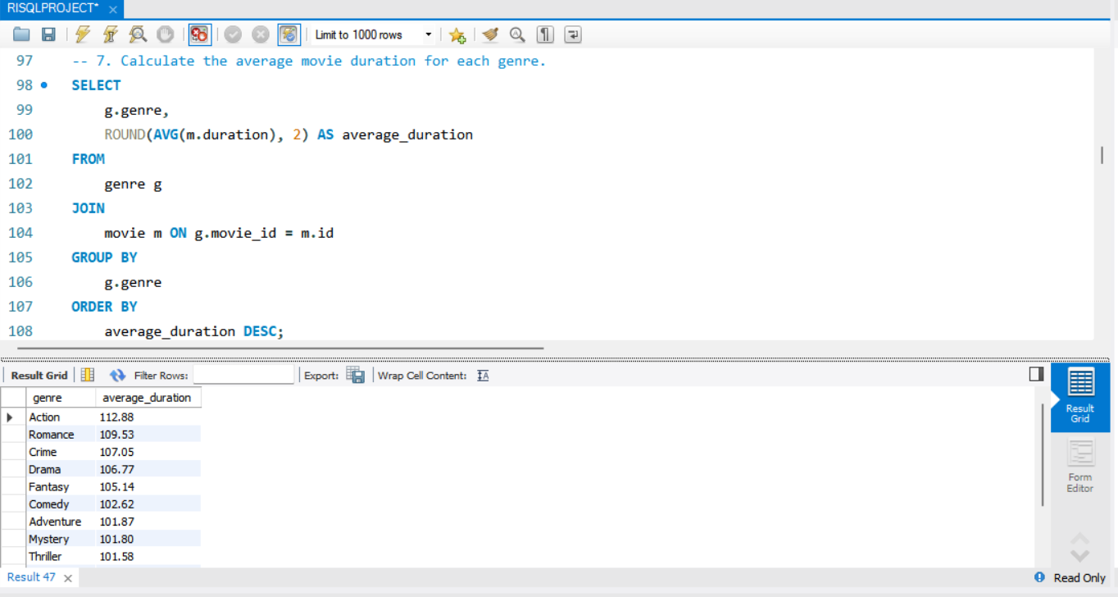
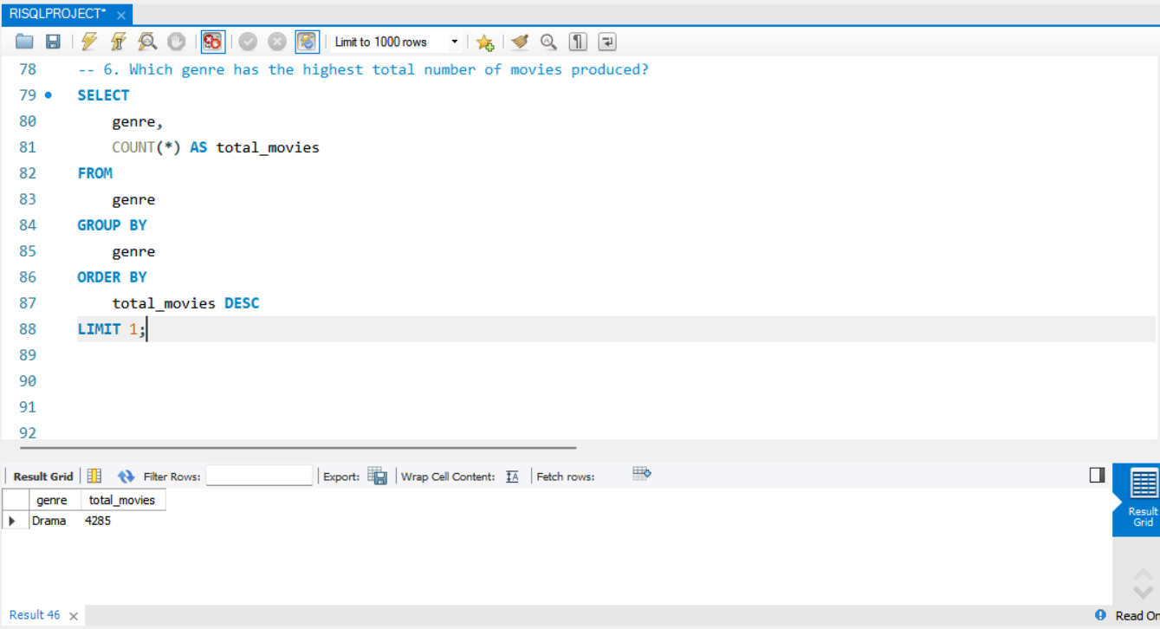
Genre-Based Analysis
Unique genres extracted.
Most common genre identified.
Avg. duration calculated per genre.
Popularity measured by count & watch-time.

Slide 6
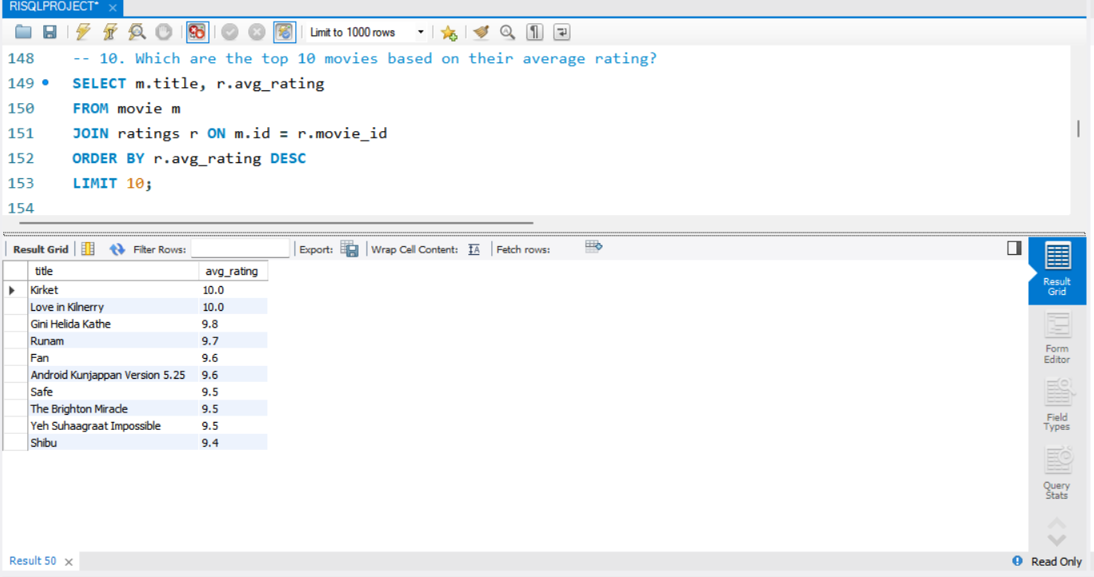
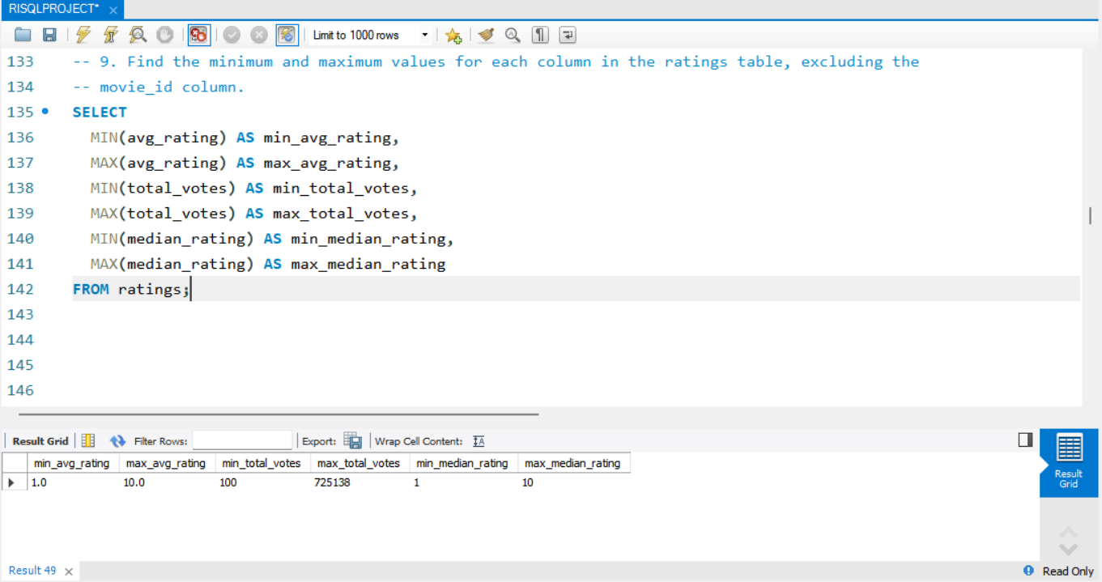
Ratings Analysis
Top 10 highest-rated movies.
Rating grouped by medians.
Min & max values across ratings.

Slide 7
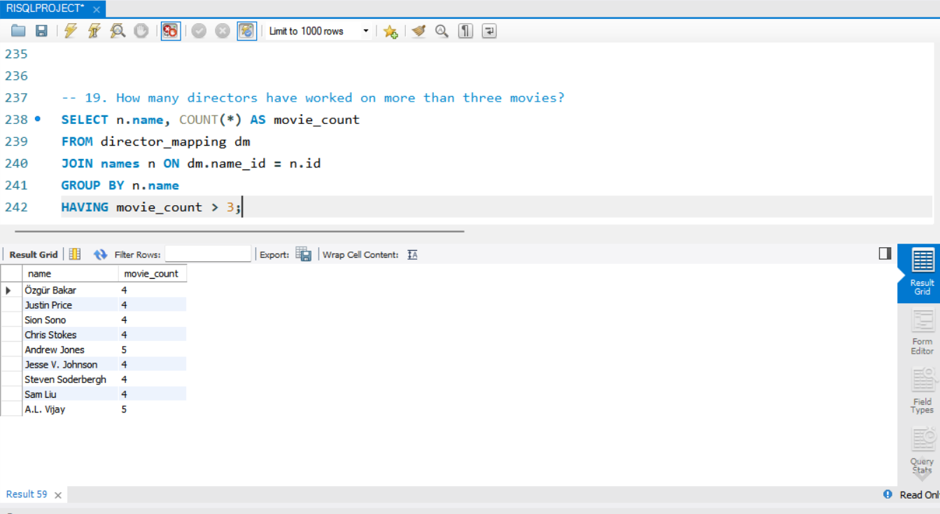
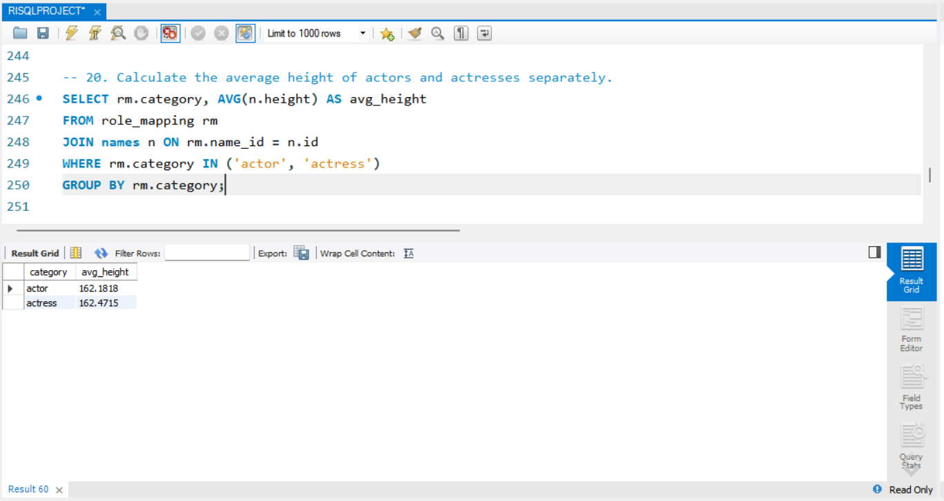
Actor & Director Insights
Actors in >3 low-rated movies (<5 avg).
Top actors (median ≥ 8).
Directors with >3 movies.
Avg height of male vs female actors.

Slide 8
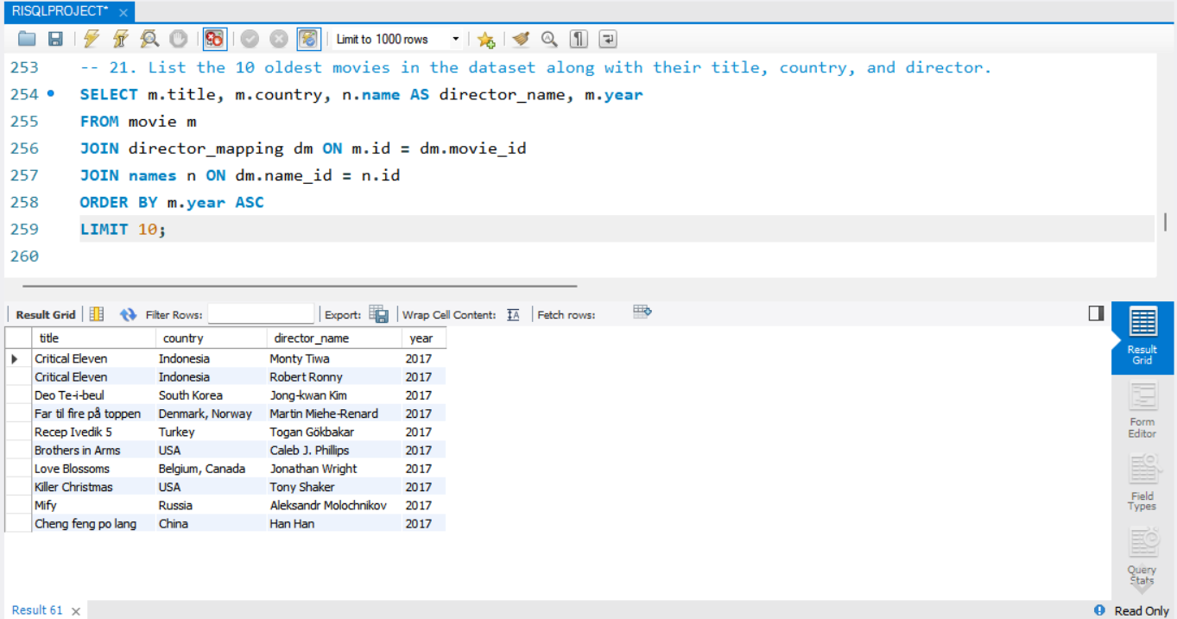
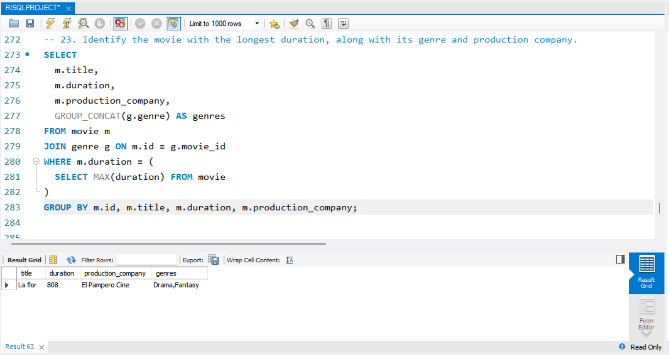
Dataset Structure
Most common movie language.
Top 3 production companies (by votes).
10 oldest movies (title, year, director).
Longest movie by duration.

Slide 9
Conclusion & Final Insights
SQL proved effective for large data.
USA/India lead movie production.
Genre & rating trends give content direction.
Notable people & companies emerged.
Reinforced skills in:
Joins
Aggregation
Filtering
Grouping

Slide 10
Thank you

